Slide 1
Concussion Policy GKHA 2023
“Draft”

Slide 2
Outline
GKHA Concussion Policy Outline:
Concussion 101 & Rowan’s Law
Recognizing a suspected concussion
Q&A
Remove-from-sport protocol, report and refer
Q&A
Initial medical assessment and diagnosis
Recovery and clinical support
Q&A
Return-to-sport protocol and medical clearance for stage 5 & 6
Q&A

Slide 3
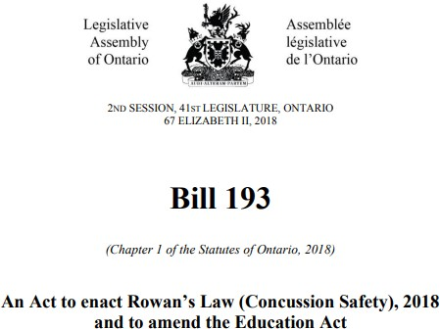
Rowan’s Law (Bill 193)
https://www.ola.org/en/legislative-business/bills/parliament-41/session-2/bill-193

Slide 4
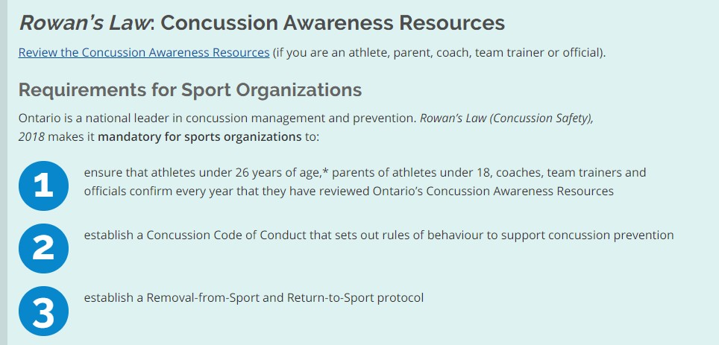

Slide 5
Rowan’s Law
As of January 2022 Rowan's Law (Concussion Safety) removal-from/return-to-sport requirements came into effect. After this date, all children and youth under the age of 25 who participate in organized sport and sport within schools will be required to seek medical assessment for two mandatory touchpoints:
Medical diagnosis: All children and youth suspected of sustaining a concussion will require medical concussion assessment and diagnosis by a physician or nurse practitioner, with a letter which confirms positive or negative diagnosis.
Medical clearance for unrestricted physical activity: All children and youth diagnosed with concussion will require medical clearance by a physician or nurse practitioner, with a letter which confirms child or youth has met criteria to participate in unrestricted sport/physical activity participation.

Slide 6
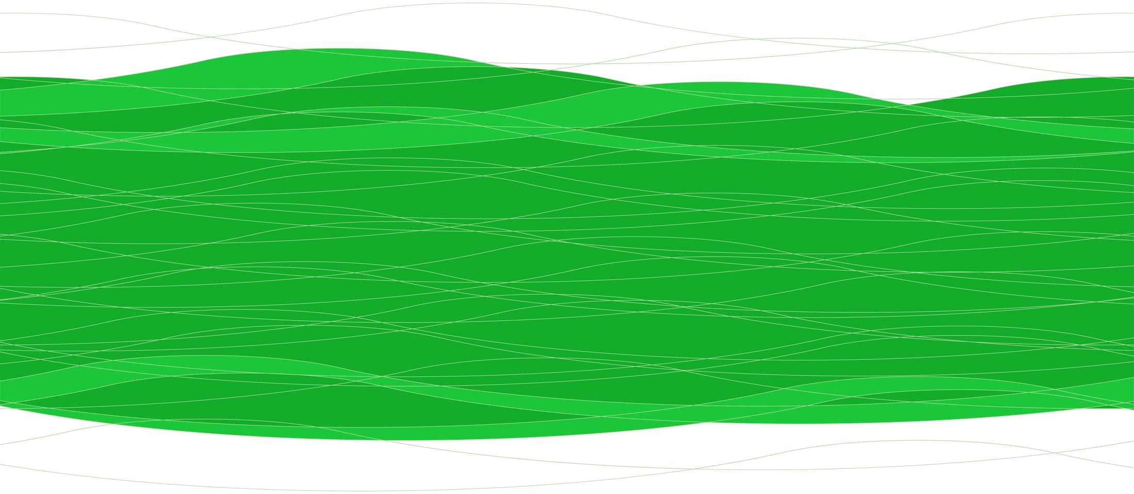
What is a concussion?

Slide 7
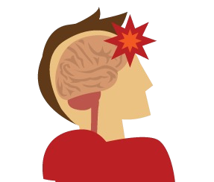
What is a concussion?
An injury to the brain
Caused by blow to head or another part of the body
“Traumatically induced physiological disruption of brain function”
Causes non-specific onset of signs and symptoms (physical, cognitive, emotional, sleep)

Slide 8
What is a concussion?
Every injury is different - A person's experience with concussion and their recovery are individual and different with each injury.
Symptoms may take up to 24-48 hours to appear - some children/youth do not recognize symptoms until at school the following day
Only need 1 symptom to treat as a suspected concussion
Concussions cannot be seen on a CT scan or MRI
There is currently no biomarker test (i.e. blood test) which can identify concussions
Canadian Guideline for Concussion in Sport, 2017

Slide 9
Concussion signs and symptoms
Physical Concussion Symptoms:
•
•
•
•
•
Headache Sensitive to light Sensitive to noise Dizziness
Nausea
Examples of signs:
Slow to get up after direct/indirect hit
Balance/walking difficulties
Uncoordinated/slow movements

Slide 10
Concussion signs and symptoms
Cognitive Concussion Symptoms:
Feeling mentally foggy
Feeling slowed down
Difficulty concentrating
Difficulty remembering
Example of signs:
Disoriented or confused
Difficulty responding to questions
Blank or vacant look
Cognitive

Slide 11
Concussion signs and symptoms
Emotional & Behavioural Concussion Symptoms:
Irritability
Sadness
Nervous/anxious
More emotional
Example of signs:
Abnormal behaviour for that child

Slide 12
Concussion signs and symptoms
Sleep Concussion Symptoms:
•
•
•
•
Drowsiness
Sleeping more/less than usual Trouble falling asleep
Fatigue
Note:
Important to monitor from a parent perspective

Slide 13
Red flag symptoms
Initiate emergency action plan
Canadian Guideline for Concussion in Sport, 2017

Slide 14
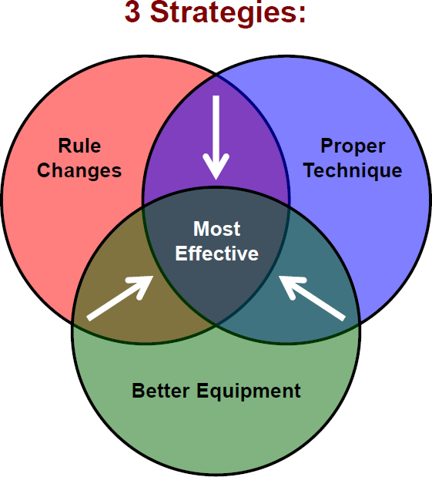
Prevention
Rule Changes: Must enforce organizational rules and penalize hits to the head
Proper Technique: Need to teach players how to prepare for contact, give and receive hits safely
Better Equipment: Helmets and mouth guards cannot fully protect a player from having a concussion, however risk can be minimized
Canadian Guideline for Concussion in Sport, 2017

Slide 15
Updates in best-practice – baseline testing
Baseline testing on children/adolescents using concussion assessment tools or tests (or any combination of tests/tools) is not recommended or required for concussion diagnosis or management following an injury.
Baseline testing refers to the practice of having an athlete complete certain concussion assessment tools/tests prior to sports participation to provide baseline measurements that can be compared to post-injury values in the event of a suspected concussion.
Current evidence does not support a significant added benefit of baseline testing athletes. This includes the Child SCAT5 and the SCAT5 tools, as well as neuropsychological and neurocognitive tests, both computerized or not.

Slide 16
Q&A
Rowan’s Law
What is a concussion
Concussion signs and symptoms
Concussion prevention

Slide 17
Remove-from-sport protocol
Recognizing, removing, reporting and referring

Slide 18
Recognition
When should a concussion be suspected?
All players who experience any concussion reported signs and symptoms or visual/observation symptoms following a blow to the head or another part of the body is considered to have a suspected concussion and must stop participation in the activity immediately.
Reminder: Symptoms of concussion typically appear immediately but may be delayed and evolve within the first 24-48 hours.

Slide 19
Recognition
3 ways to recognize signs and symptoms of a suspected concussion:
Self-reported signs & symptoms
Observed signs & symptoms
Peer-reported signs & symptoms from child/youth, teachers, coaches and/or parents

Slide 20
Recognition
Figure 1: GENERAL CONCUSSION SYMPTOMS
Headache | Feeling mentally foggy | Sensitive to light
Nausea | Feeling slowed down | Sensitive to noise
Dizziness | Difficulty concentrating | Irritability
Vomiting | Difficulty remembering | Sadness
Visual problems | Drowsiness | Nervous/anxious
Balance problems | Sleeping more/less than usual | More emotional
Numbness/tingling | Trouble falling asleep | Fatigue
Canadian Guideline for Concussion in Sport, 2017

Slide 21
Recognition
Figure 2: VISUAL/OBSERVABLE SYMPTOMS
Lying down motionless on the playing surface
Slow to get up after a direct or indirect hit
Disorientation or confusion, or an inability to respond appropriately to questions
Blank or vacant look
Balance, gait difficulties motor incoordination, stumbling, slow labored movements
Facial injury after head trauma
Canadian Guideline for Concussion in Sport, 2017

Slide 22
Recognition
Initiate emergency action plan
Canadian Guideline for Concussion in Sport, 2017

Slide 23
Remove-from-sport
Any child/youth who experiences signs and symptoms of concussion following a blow to the head or body will be considered to have a suspected concussion and must stop participation in the sport activity immediately
Who is responsible for recognising a suspected concussion? All team officials hold a responsibility to recognise the signs and symptoms of a suspected concussion
Who is responsible for removal from play? When present, team trainers hold the final decision to remove players with a suspected concussion. If there is doubt whether a concussion has occurred, it is to be assumed that it has. If no team trainer is present order of next most responsible individuals:
An individual with trainer certification
Team head coach
Canadian Guideline for Concussion in Sport, 2017

Slide 24
Remove-from-sport
Once removed the trainer must:
Monitor the player until a parent/guardian is contacted or on-site. Players with a suspected concussion should not be left alone. Older players should not drive themselves.
Complete a Suspected Concussion Report Form immediately after a concussion is suspected. Trainer must provide copies of the Suspected Concussion Report Form to:
The individual’s parents/guardian to bring to their medical appointment
One copy to the head trainer petertripp@Hotmail.com & riskmanagement@greaterkingstonhockey.com
Note: If the form was completed by another individual with trainer certification or team head coach (as trainer was not present), that individual must send to the team trainer who review and submit to head trainer
Recommend to the players parent/guardian that they see a medical doctor or nurse practitioner as soon as possible for assessment

Slide 25
Suspected concussion report form

Slide 26
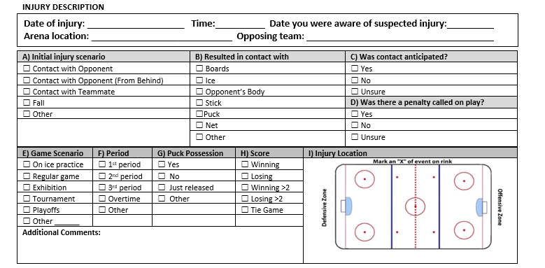
Suspected concussion report form

Slide 27
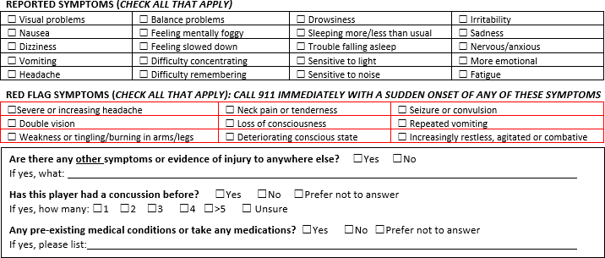
Suspected concussion report form

Slide 28
Suspected concussion report form

Slide 29
Suspected concussion report form
Importance of suspected concussion report forms:
Catalyst: Initiates the concussion policy process
Recording: Record of the suspected injury
Communicating: Consistent way of communicating suspected injuries to parents, head coaches and medical community
Surveillance: Can support clubs/districts in injury data collection

Slide 30
Refer to medical assessment/diagnosis
Seeking medical assessment: If a player has been deemed to have had a suspected concussion, it is the parent/guardian’s responsibility to take the player to see a medical doctor or nurse practitioner as soon as possible. Players with suspected concussions may not return to any GKHA activity until they have received medical assessment and submitted necessary documentation.
Required type of initial medical assessment: In addition to nurse practitioners, the types of medical doctors that are qualified to evaluate patients with a suspected concussion include: family physician, pediatrician, emergency room physician, sports-medicine physician, neurologist or internal medicine and rehabilitation (physiatrists). Documentation from any other source will not be acceptable.
Note: Written documentation by a medical doctor or nurse practitioner may be provided in any format from the medical assessment. A recommended Medical Assessment Letter template can be found in Parachute’s Canadian Guideline for Concussion in Sport.
Canadian Guideline for Concussion in Sport, 2017

Slide 31
Medical assessment and diagnosis – NO concussion
Parents/Player | Trainer
Parent/guardian must take the written documentation from the medical assessment (highlighting that the player did not have a concussion), and give this document to the team trainer. Parent/guardian should continue to monitor the player for at least 24-48 hours after the event, as signs and symptoms may be delayed or evolve over that period. | Team trainer to submit medical documentation to the Head Trainer, Peter Tripp and Risk Management, before the player is permitted to return to a hockey activity (petertripp@Hotmail.com riskmanagement@greaterkingstonhockey.com ) Team trainers and head coaches will not allow return until documentation has been received. Team trainers have the right to refuse a player to return to any hockey activity if they deem the player unfit to do so.

Slide 32
Medical assessment and diagnosis – YES concussion
Parents/Player | Trainer
Parent/guardian must take the written documentation from the medical assessment (highlighting that the player has been diagnosed with a concussion), and give this document to the team trainer The player is to begin stage 1 of the return-to- sport protocol. | Team trainer to submit medical documentation, in addition to the Hockey Canada Injury Report Form, to the Head Trainer now that it is a confirmed injury/concussion. Team trainers and head coaches will follow gradual return-to-sport protocol and ensure no participation in stage 5 and 6 sport activities until medical clearance (See details on page 9-10)

Slide 33
Q&A
Recognize the sign and symptoms (classroom, sport, other activities)
Remove child/youth from the activity
Report suspected injury to child/youth’s parent/guardian and a team/club designate. Ensure they are not left alone and do not drive themselves
Refer child/youth to medical doctor or nurse practitioner for assessment and diagnosis

Slide 34
Recovery and clinical support

Slide 35
Changes is rest recommendation
The shift to an active rehabilitation approach
Rest beyond 48 hours and strict limitations to low-risk activity is no longer recommended.
Encourage patients with post-concussion symptoms to engage in cognitive activity and low-risk physical activity as soon as tolerated while staying below their symptom-exacerbation thresholds. (Reed, N. & Zemek, R. et al 2019)
Early physical activity is associated with 5.8 lower odds of experiencing persistent symptoms. Patients who did not engage in early exercise had longer symptom duration, greater odds of post-injury headache, and greater symptoms at initial clinical evaluation (Wilson et al 2020) (Krainin et al 2021).
Complete absence from the school environment for more than one week is not generally recommended.
Prolonged rest and periods of restricted activity may place children and youth at risk for secondary issues and contribute to the chronicity of concussion symptoms (Schneider et al, 2013; Silverberg et al 2019; Thomas et al 2015)

Slide 36
Understanding who may need more support
5
Increased evidence for identification of high risk youth and need for early referral to specialized care
Recommendation 2.1b: Note common modifiers that may delay recovery and use a clinical risk score to predict risk of prolonged symptoms. (Reed, N. & Zemek, R. et al 2019)
Recommendation 3.5: Consider early referral (prior to 4-week post-injury) to an interdisciplinary concussion team in the presence of modifiers that may delay recovery. (Reed,
N. & Zemek, R. et al 2019)

Slide 37
Understanding who may need more support
Common modifiers:
Age (13-18 higher risk)
Sex (female higher risk)
Duration of recovery from a previous concussion
High pre-injury symptom burden
High symptom burden at initial presentation
Clinical evidence of vestibular or oculomotor dysfunction
Personal and family history of migraines
History of learning or behavioural difficulties
Personal and family history of mental health issues
Family socioeconomic status/education – High & Low
Family stress

Slide 38
Does history of concussion influence recovery?
Duration of recovery from previous concussions (i.e. >4 weeks of symptoms) is a factor which has increased likelihood of a longer recovery with subsequent concussions
Number of previous concussions has not shown as a consistent factor for prolonged recover in the research – unless there is multiple concussion injuries in a short time period.
This is why it’s important to follow active but gradual return-to-sport and school protocols to limit risk of another injury during concussion recovery
(Reed, N. & Zemek, R. et al 2019)

Slide 39
Return-to-sport protocol

Slide 40
Return-to-sport
What should return to sport look like:
Diagnosis received and initial rest period of 24-48 hours
Symptoms limited activity 🡪 Reintroduce work/school
Light aerobic exercise 🡪 Increase heart rate
Sport-specific drills 🡪 Add movement
Non-contact drills 🡪 Exercise, coordination and increased thinking
Follow up with medical doctor or nurse practitioner for clearance
Full contact practice 🡪 Restore confidence and assess functional skill by coaching staff
Return to full sport participation/competition
McCrory et al. 2016

Slide 41
Return-to-sport
Parent/guardian and the player are responsible to ensure that each stage of the return- to-sport protocol is followed appropriately and the required signatures are completed at each stage.
Players should complete each stage of the return-to-sport protocol for a minimum of 24 hours without new or worsening symptoms before progressing to the next stage. If a player experiences, new or worsening symptoms at a particular stage they should return to the previously successful stage.
McCrory et al. 2016

Slide 42
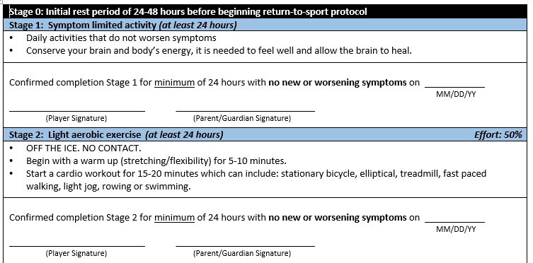
Return-to-sport
McCrory et al. 2016

Slide 43
Return-to-sport – Stage 3
McCrory et al. 2016

Slide 44
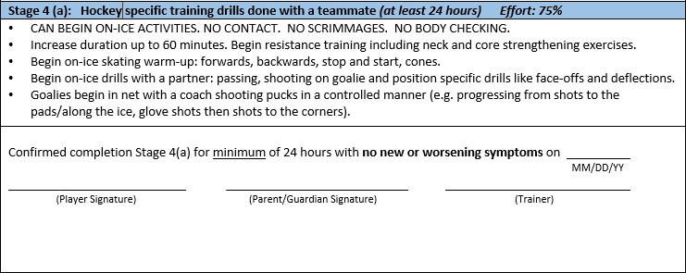
Return-to-sport – Stage 4 (a)
McCrory et al. 2016

Slide 45
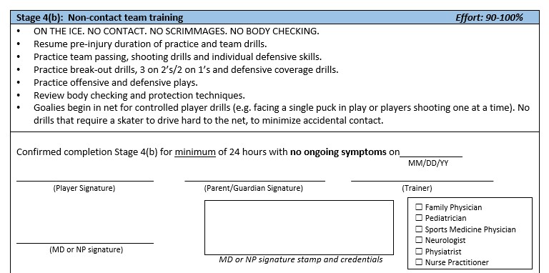
Return-to-sport – Stage 4 (b)
McCrory et al. 2016

Slide 46
Medical Clearance
Once Stages 1-4 (b) of the return-to-sport protocol have been completed, the player must receive medical clearance to proceed to Stage 5: Full contact practice with team. A player is not permitted to return to Stage 5: Full contact practice with team or Stage 6: Game Play until written permission by a medical doctor/nurse practitioner.
In addition to nurse practitioners, the types of medical doctors that are qualified to support medical clearance for concussion include: family physician, pediatrician, sports-medicine physician, neurologist or internal medicine and rehabilitation (physiatrists). Documentation from any other source will not be acceptable.
Written clearance by a medical doctor or nurse practitioner may be provided in any format from the medical appointment.
McCrory et al. 2016

Slide 47
Prepping for first game back
McCrory et al. 2016

Slide 48
Medical clearance
Parents/Player | Trainer and Coach
Must provide the trainer with: Written clearance from the medical doctor/nurse practitioner (highlighting player is safe to return to stage 5 & 6 Return-to-sport protocol with all signatures completed | It is the responsibility of the team trainer to submit written medical clearance and return-to-sport protocol with signatures completed to the Head Trainer, Barb Matthews, prior to the player participating in Stage 6: Game Play. Coaches do not progress to game play until player has regained their pre-injury skill-level and player is confident in their ability to return to game play. Team trainers have the right to refuse a player to return to any hockey activity if they deem the player unfit to do so.

Slide 49
Special considerations
What happens when a suspected concussion from a GKHA activity is not identified/reported until days or weeks after the activity?
Action: Remove from sport, report and refer a suspected concussion to medical assessment
Rationale: Immediately upon the concussion being suspected and/or reported to team officials, the trainer is to complete a Suspected Concussion Report Form and recommend that the player see a medical doctor/nurse practitioner as soon as possible.
McCrory et al. 2016

Slide 50
Special considerations
What happens when a child/youth sustains a concussion from a non GKHA activity (i.e. school, other sports, non club/team related games or training)?
Action: request or obtain medical diagnosis
Rationale: As the concussion did not happen at a club/team activity, no Suspected Concussion Report Form is needed. However, regardless of where a concussion was sustained child/youth is required to follow a return-to-sport protocol
McCrory et al. 2016

Slide 51
Q&A
Recovery and best practice updates
Clinical support
Return-to-sport protocol
Medical clearance requirements

Slide 52
Stakeholder responsibilities – team trainer
Recognizing and removing:
Recognizing the signs & symptoms of concussion
Removing players, ensuring their monitored and recommend they seek medical attention
Completing the following forms:
Suspected Concussion Report Form
Hockey Canada Injury Report From
Submitting all forms received from parents from medical appointments to the Head Trainer & Risk Management
Diagnosis and clearance
Have the right to refuse a player to return to any GKHA hockey activity if they deem the player unfit to do so
Ensuring all players with a suspected concussion to not return to contact activity until medically cleared to do so

Slide 53
Stakeholder responsibilities – head coaches
Under this policy head coaches are responsible for:
Recognizing and supporting removing:
Recognizing the signs & symptoms of concussion
Create a team culture where players feel comfortable reporting injuries
Trust your trainer and know that they have the final say about removing a player
Facilitating gradual return-to-sport at practices
Modifying practices and setting personalized training plans for players who are in return-to-sport protocol
Ensuring a safe practice environment
Ensure players have regained their pre-injury skill-level and player is confident in their ability to return to activity.
Ensuring all players with a suspected concussion to not return to contact activity until medically cleared to do so

Slide 54
Stakeholder responsibilities – parents and players
Parents
Obtain documentation from medical professional
Most responsible person for gradual return-to-sport protocol
Co-sign all stages in return-to-sport protocol
Communicate with team trainer and send documentation
Players
Be honest with trainers, coaches and parents
Gradually move through return-to-sport protocol
Co-sign all stages in return-to-sport protocol
Referees
Recognize the signs & symptoms of concussion
Enforce rules and penalize hits to the head
Report suspected concussions to team trainer

Slide 55
Information about the GKHA Concussion Policy can be found at:
https://greaterkingstonhockey.com/
Heading -> Risk Management

